Slide 1
Gym Modernization: DIII
By Alek, Akram, Daniel, Jay, Tom, PK

Slide 2
Process Model DFDs

Slide 3
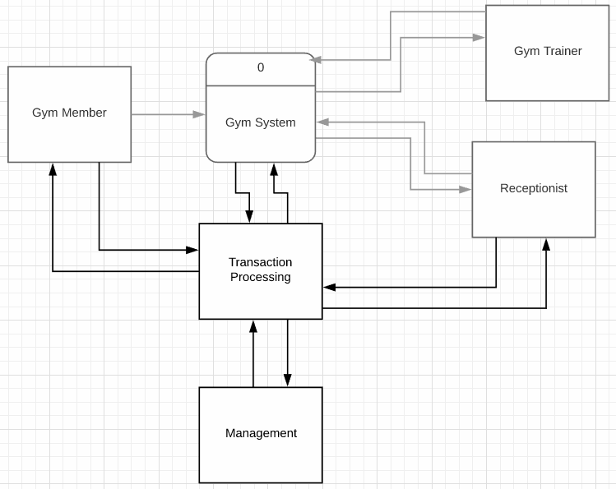
Context Diagram

Slide 4
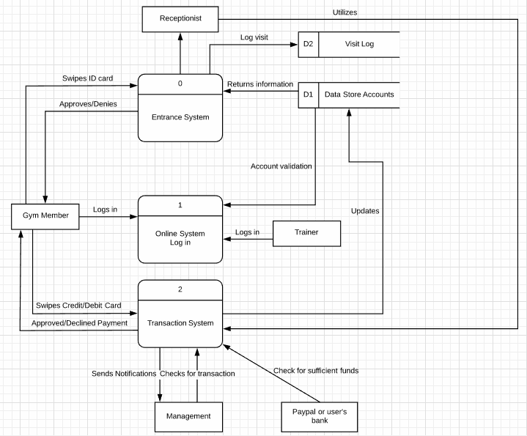
Level 0 Diagram

Slide 5
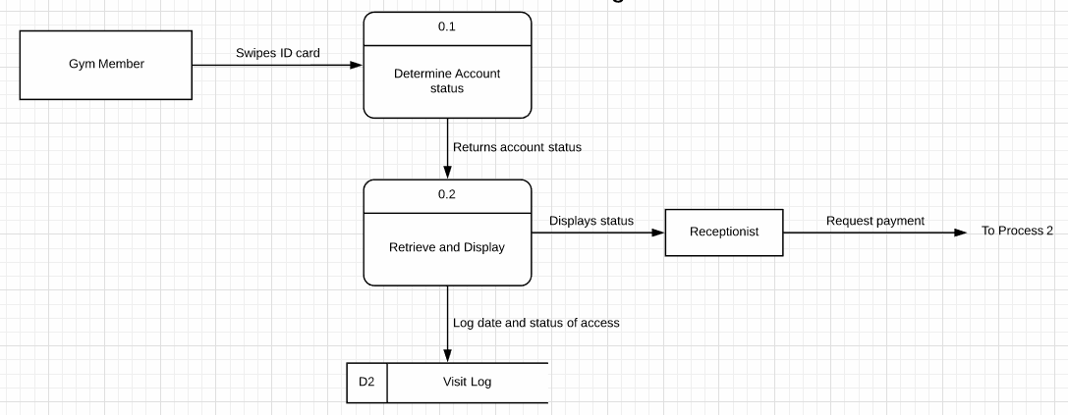
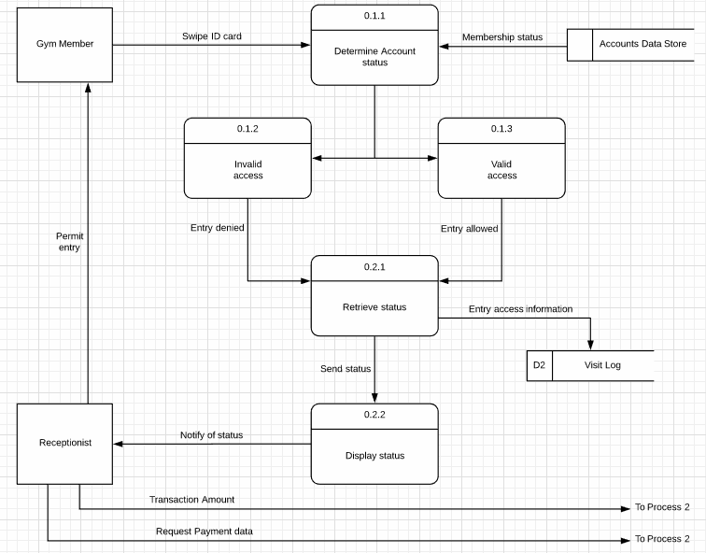
Level 1/Level 2 Entrance System Diagrams

Slide 6
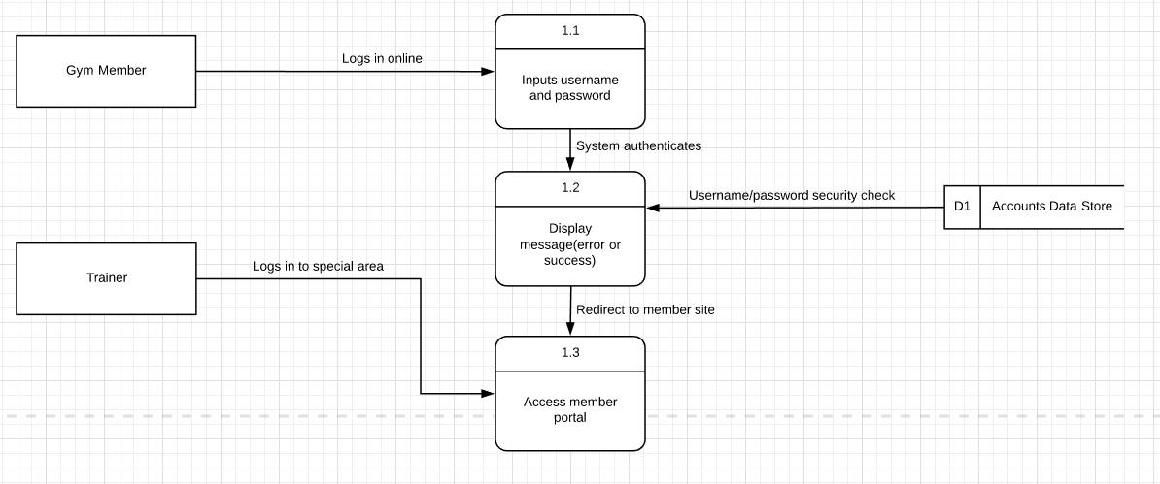
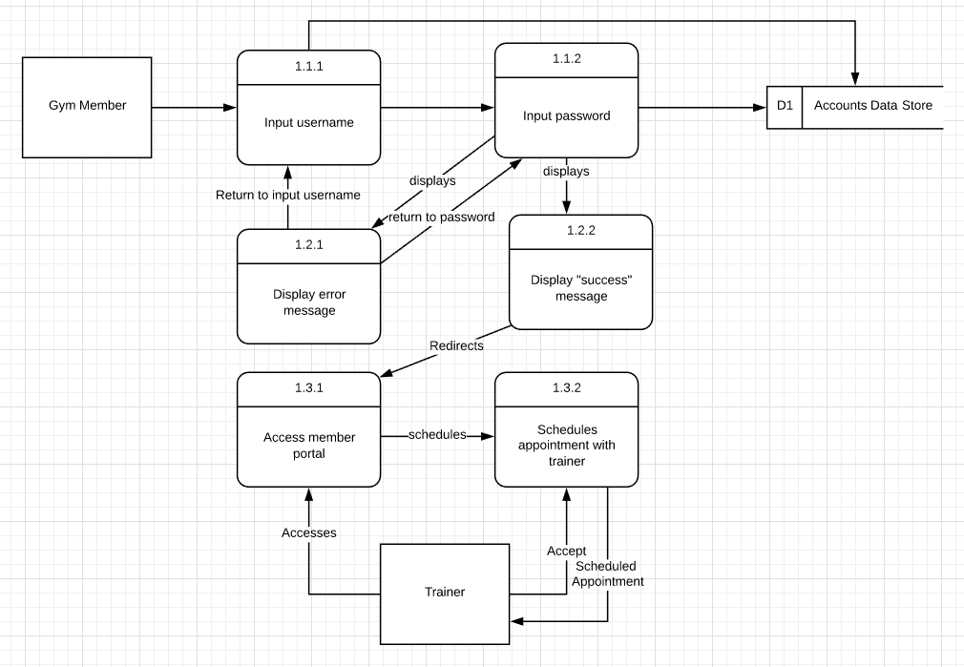
Level 1/Level 2 Online Login Diagrams

Slide 7
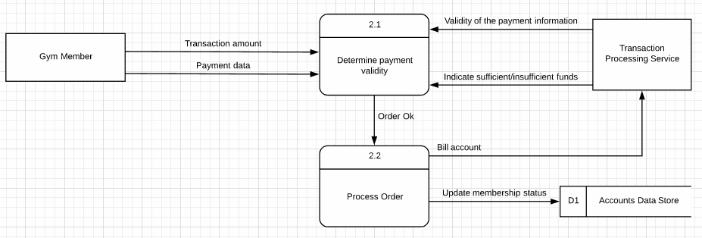
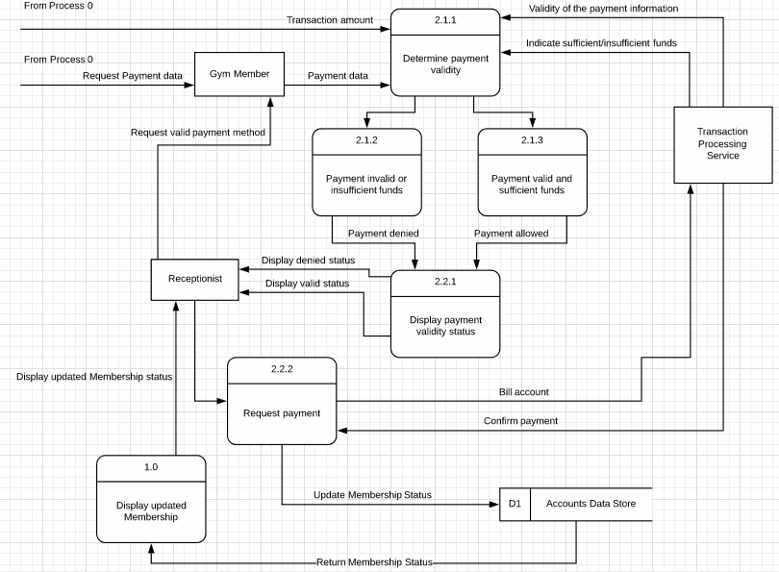
Level 1/Level 2 Transaction Processing Diagrams

Slide 8
Revised Use Cases

Slide 9
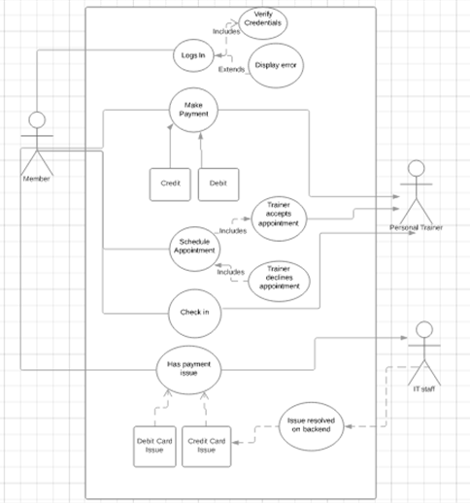
Use Case #1

Slide 10
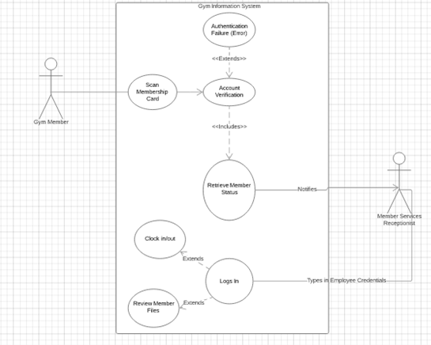
Use Case #2

Slide 11
DFD Definitions

Slide 12
Processes
0 Entrance System {
This is where member swipes ID card for entry
WHEN cardSwipe THEN
Transmit Credentials
}
1 Online System Login {
This is where member accesses online system
if(username != NULL || password != NULL)
send credentials to verify
Retrieve Profile
else
Return no_data_found
}

Slide 13
Process Cont..
2 Transaction System {
This is where member pays for membership
If(cardExpired = true || cardInvalid = true)
Return error
Else
send card to TPS
If (Declined){
Alert(Error: unable to authorize credit card)
}
Else{
Print receipt
}
}

Slide 14
Process 0.1 0.2
0.1 Determine Account Status {
Verify membership status
Send information to data flow 0.1.2 and 0.1.3
Invalid access = Entry denied
Valid access = Entry allowed
}
0.2 Retrieve and Display {
Retrieve data flow information from 0.1
Logs visit
Sends data flow to 0.2.2 to display status to receptionist
}

Slide 15
Process 0.1 0.2
2.1 Determine Payment Validity {
Retrieves data flow information from process 0, gym member, and transaction processing service
Sends data flow to 2.1.2 and 2.1.3
Sufficient funds = payment allowed
Insufficient funds = payment denied
}
2.2 Process Order {
Retrieves data flow information from 2.1.2 and 2.1.3
Displays and sends data flow to Receptionist with valid or invalid status of payment
}

Slide 16
External Entities
Gym Member
Type: External Entity
Description: Member who goes to gym, has ID card
Input Data Flows: Approved/Declined Payment, Approves/Denies ID Card
Output Data Flows: Swipes ID Card, Logs in, Swipes Credit/Debit Card
Receptionist
Type: External Entity
Description: In charge of physical check in/check out of gym members, logs each visit
Input Data Flows: Displays/notifies status
Output Data Flows: Utilizes transaction system, requests payment, allows access

Slide 17
External Entities (con’t)
Personal Trainer
Description: Trainer that can be assigned to gym member via online appointment. Trainer would log in to member area of system.
Input data flows: schedules appointment
Output data flows: accepts appointment, logs in/accesses
Transaction Processing
Description: Consists of bank or Paypal.
Input data flows: Swipe debit/credit card, Bill account, check for sufficient funds
Output data flows: Validate funds(sufficient/insufficient). Validate payment
Management
Description: Owners of gym
Input data flows: Sends notifications
Output data flow: Checks for transaction

Slide 18
Data Flows
Data Store Info
D1 to 0
Information from Data Store
ID Card
Gym Member to 0
Unique integer derived from barcode on ID card
ID Approval/Denial
0 to Gym Member
Validation response from Entrance System
Member Login
Gym Member to 1
Credentials for member online account including ID and Password
Credit/Debit Card
Gym Member to 2
Card Number, Expiration Date, Security Code, Card Holder Name, Billing Address, Zipcode

Slide 19
Data Flows Continued
Pay Approval/Denial
2 to Gym Member
Validation response from Transaction System
Updates
2 to D1
Transaction information from Transaction System including bills, payments, and statements
Account Validation
D1 to 1
Validation response from Data Store Accounts
Trainer Login
Trainer to 1
Credentials for trainer online account including ID and Password
Notifications
2 to Management
Notification messages from Transaction System

Slide 20
Data Flows Continued
Check
Management to 2
Message Received Confirmation from Management
Sufficient Funds Check
Paypal or user’s bank to 2
Inquiry from outside source to Transaction System
Visit Log
0.2 to D2
Log of information generated by Entrance System
Schedule
1.3.1 to 1.3.2 to Trainer
Schedule information and requests
Schedule Acceptance
Trainer to 1.3.2
Response to Request from 1.3.2

Slide 21
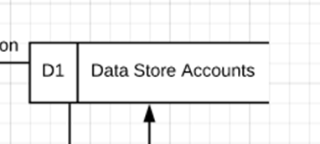
Data Store: Accounts
Data store name: Accounts
Description: Central repository for all past and present members
Alternative name(s): Member Database
Attributes: Member name, Member ID, Member address, Member email, Member Credit Card
Volume and frequency: Estimated 5,000 gym members and, on average, there are ~65 updates per day

Slide 22
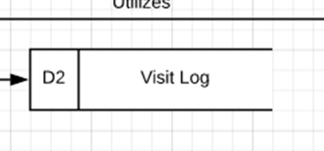
Data Store: Visit Log
Data store name: Visit Log
Description: Central repository for all member entrance attempts (regardless of status)
Alternative name(s): N/A
Attributes: Log ID, Member name, Member ID, Date & Time
Volume and frequency: Estimated 500 gym member entrances, within every couple of minutes

Slide 23

Data Store: Transaction Log
Data store name: Transaction Log
Description: Central repository that stores all transactions made for billing purposes
Alternative name(s): Billing Account
Attributes: Transaction ID, Member ID, Payment Method (last 4 digits), Date & Time
Volume and frequency: Payments are accepted between the 1st and 10th of every month. The volume is equal to the number of active members who attend our gym

Slide 24
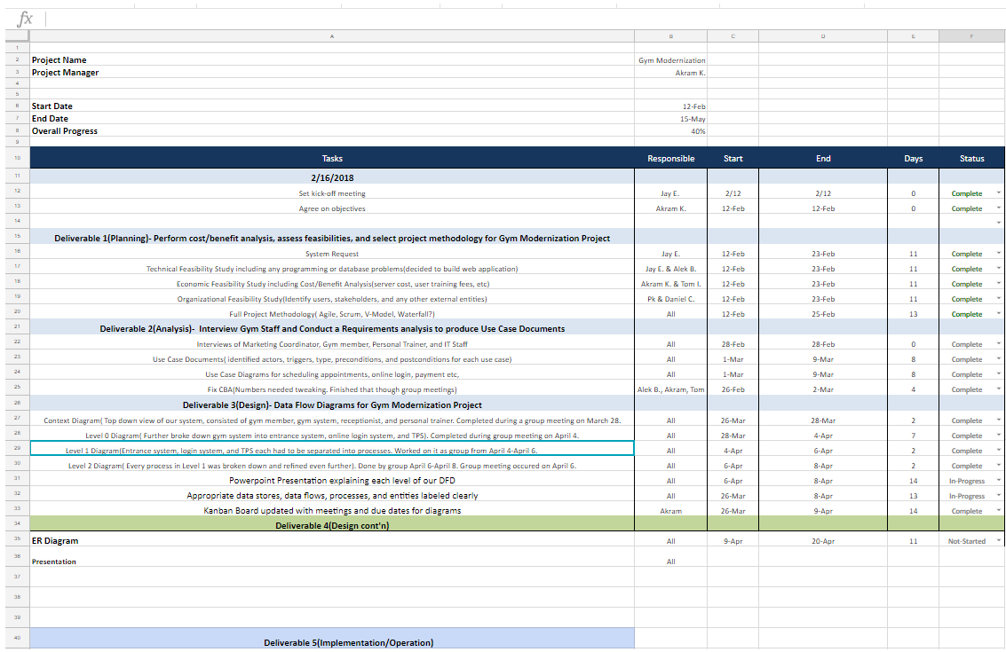
Project Work Plan
https://docs.google.com/spreadsheets/d/1ejx_Ox2Rqxv6cPuh-hH_Er3CNOKHGU0_9i3guQB23bU/edit#gid=511849719

Slide 25
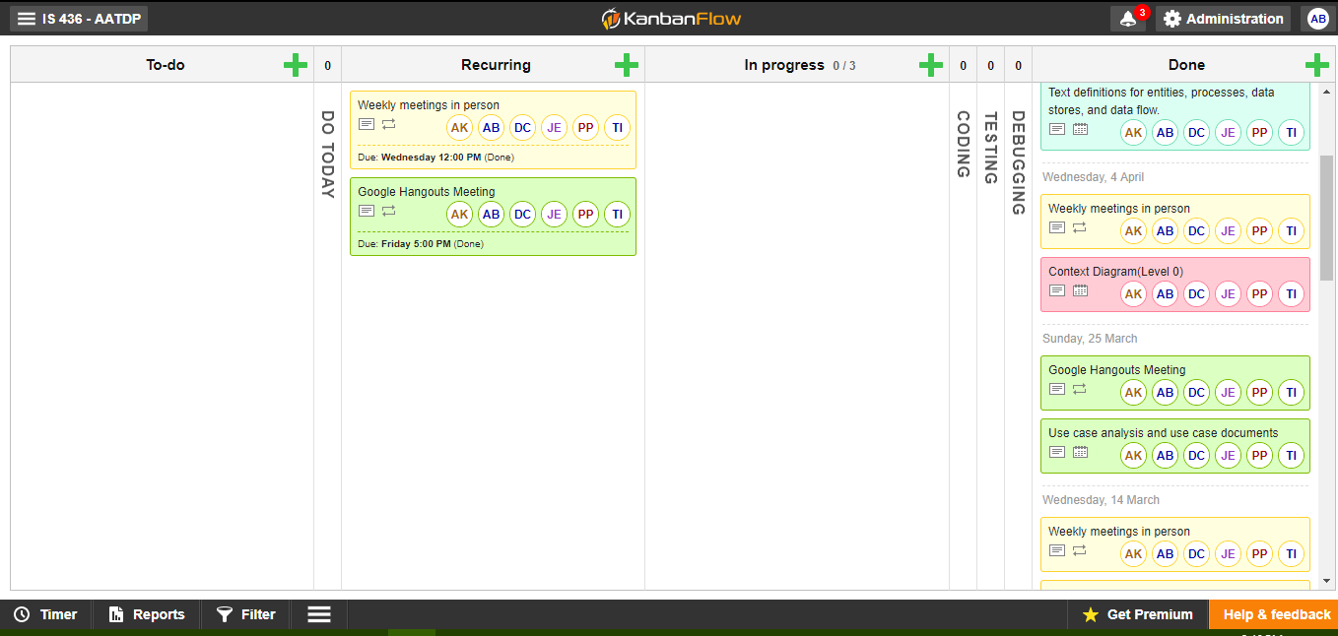
Kanban board
https://kanbanflow.com/board/nyGh4ZN5

Slide 26
Questions?

